Slide 1

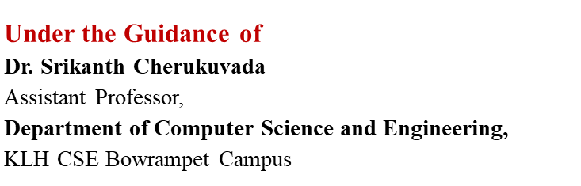
PharmaVerse AI: An Agentic Pharmaceutical Supply Chain Monitoring and Drug Traceability Ecosystem
SOA and Microservices Project Review-3
Thursday, September 24th, 2026
Team-23:
Y. Nihitha - 2420090099
A.Sri Anitha - 2420090117
T. K. Amulya - 2420030434
S. Harini - 2420030523

Slide 2
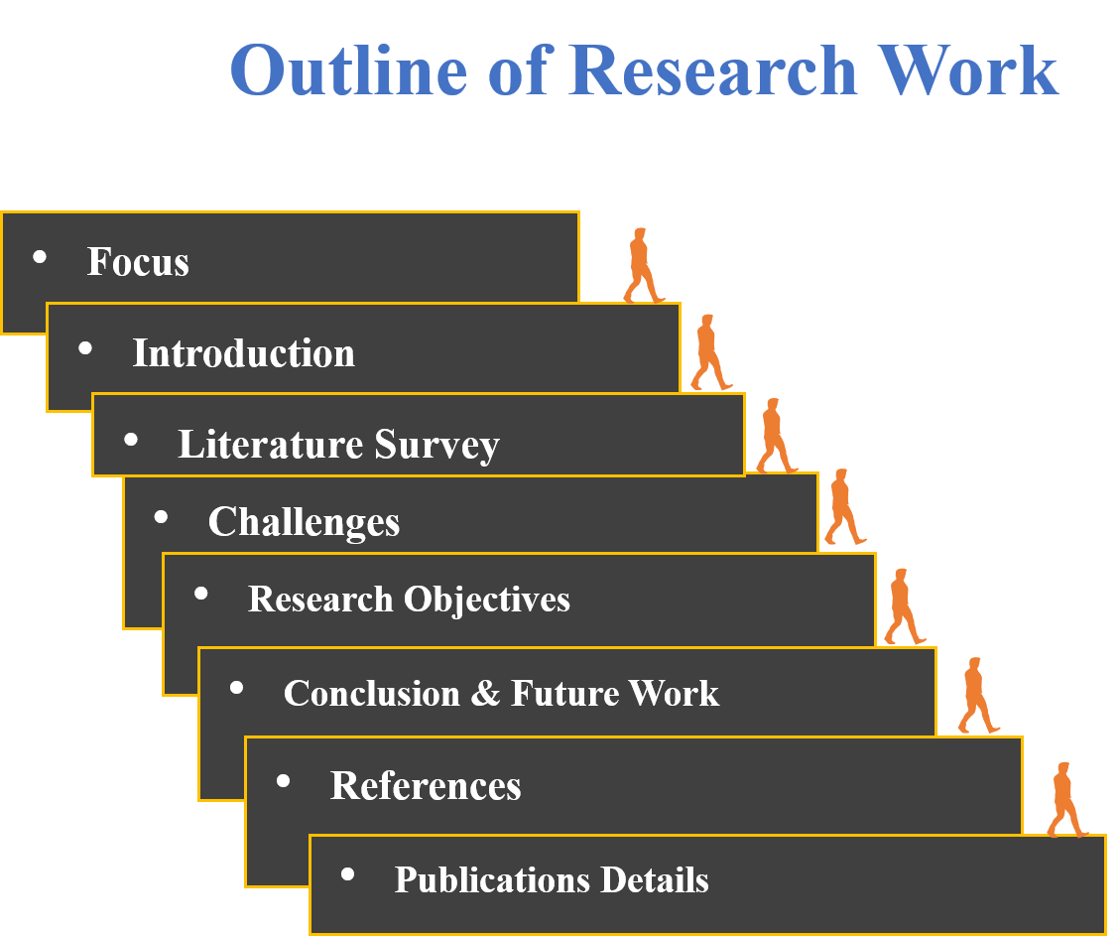

Slide 3
Problem Statement
Traditional pharmaceutical supply chains rely on fragmented and centralized systems, making drug tracking, verification, and monitoring inefficient.
Counterfeit drugs, poor visibility, and supply chain disruptions can compromise medicine safety and availability.
Existing solutions often lack real-time tracking, secure data sharing, and end-to-end drug traceability.
There is a need for a secure, transparent, and real-time system that can authenticate medicines, monitor their movement, and detect supply chain anomalies.
The proposed PharmaVerse AI integrates Hyperledger Fabric, RFID, IoT, FastAPI, Docker, PostgreSQL, and QR-based traceability to enable secure drug tracking, anti-counterfeiting, and intelligent pharmaceutical supply chain monitoring.

Slide 4
Innovation, Creativity, and Novelty
Blockchain-Enabled Trust: Hyperledger Fabric provides a permissioned, tamper-resistant ledger for secure and accountable sharing of pharmaceutical transaction records among authorized stakeholders.
Physical–Digital Drug Linking: RFID + QR traceability creates a digital identity for medicines and links their physical movement with verifiable supply-chain records.
Real-Time IoT Monitoring: IoT devices continuously capture relevant movement and environmental data, improving visibility beyond conventional static tracking.
Agentic AI-Based Intelligence: AI agents can analyze supply-chain events, identify abnormal patterns, detect potential disruptions, and support intelligent monitoring rather than merely storing transaction data.
End-to-End Traceability: The proposed architecture connects manufacturing → distribution → transportation → pharmacy → verification, enabling complete medicine provenance.
Integrated Anti-Counterfeiting: Combining blockchain records with QR/RFID verification enables stakeholders to validate medicine identity and detect inconsistencies between physical products and digital records.
Novelty: PharmaVerse AI unifies blockchain, IoT/RFID, QR traceability, and agentic intelligence into a single pharmaceutical supply-chain ecosystem, moving beyond conventional tracking systems toward secure, real-time, intelligent, and anomaly-aware drug traceability.

Slide 5
Project Design
Objective:
Develop a secure and traceable pharmaceutical supply-chain system using AI + Blockchain.
Core Design Components :
Drug & Batch Management – registration and batch creation
Supply-Chain Tracking – shipment, receipt and ownership transfer
QR/RFID Traceability – identity assignment and verification
Counterfeit Detection – suspicious identity mismatch flagging
IoT Monitoring – temperature, humidity, location and movement
AI Risk Alerts – AI-generated alerts stored as audit records
Immutable History – complete batch provenance and audit trail
Key Design Principle:
Blockchain acts as the trusted audit layer, while AI and operational processing remain outside the blockchain.

Slide 6
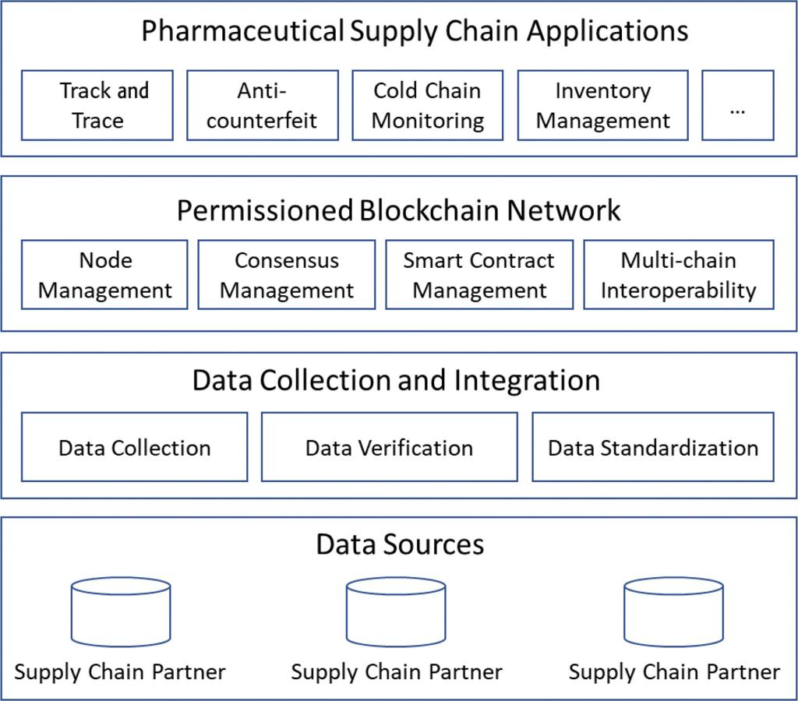
System Architecture

Slide 7
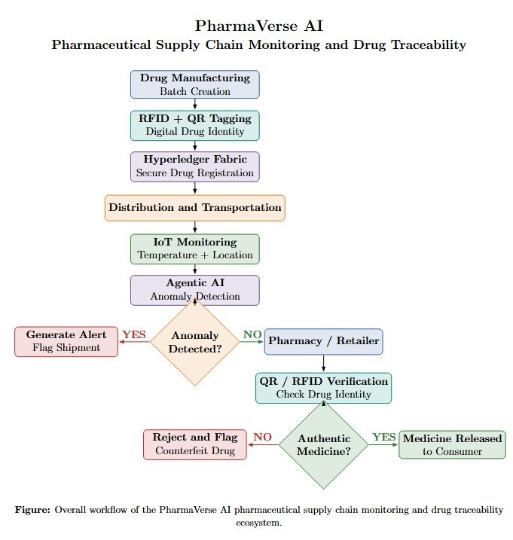
Workflow

Slide 8
Methodology Adopted
Methodology Adopted
Drug Registration & Batch Creation – Register medicines and create unique pharmaceutical batches.
QR/RFID Tagging – Assign unique QR and RFID identities to each drug batch.
Blockchain Recording – Store critical drug, batch, ownership and transaction records using Hyperledger Fabric.
Supply-Chain Tracking – Track shipment, transportation, receipt and ownership transfer.
IoT Monitoring – Monitor parameters such as temperature, humidity, location and movement during transportation.
AI-Based Anomaly Detection – Analyze supply-chain data to identify abnormal or high-risk conditions.
Alert Generation – Generate alerts when anomalies or potential risks are detected.
QR/RFID Verification – Verify the medicine's identity at the pharmacy/retailer stage.
Counterfeit Detection – Identify mismatched or suspicious QR/RFID information and flag the medicine.
Immutable Traceability – Maintain the complete batch history and audit trail on the blockchain.

Slide 9
Methodology Features
Each drug and batch receives a unique identity
Supply-chain transactions are recorded on the ledger
Ownership is validated before transfer
QR/RFID mismatches generate suspicious results
IoT events provide shipment-monitoring information
AI-generated risk alerts are recorded for auditability
Fabric ledger history maintains the batch lifecycle

Slide 10
Technical Soundness of the Project
The technical soundness of PharmaVerse AI can be demonstrated through its blockchain architecture, security mechanisms, integration, and testing.
1. Appropriate Blockchain Technology : The project uses Hyperledger Fabric 2.5, a permissioned blockchain suitable for a pharmaceutical supply chain where participating organizations have known identities. The implementation uses Fabric CA, Node.js chaincode, Fabric Gateway, Org1MSP and Org2MSP.
2. Smart Contract-Based Validation : Business rules are implemented through Node.js chaincode. For example, ownership transfer is permitted only when the requested source owner matches the batch's current owner. Unauthorized transfers are therefore rejected by the blockchain logic.
3. Immutable Audit Trail : Important events are recorded on the Fabric ledger, and historical states can be retrieved using Fabric's ledger-history functionality. This provides traceability of the drug from registration through shipment, ownership transfer and possible counterfeit detection.
4. Security Testing : The project includes a demonstrated unauthorized-transfer test. An unauthorized user attempted to transfer a batch, and Fabric rejected the transaction while preserving the existing owner and flagged state.

Slide 11
5. Counterfeit Detection Testing : The system was tested using both correct and incorrect RFID information:
Correct QR + RFID → AUTHENTIC
Correct QR + incorrect RFID → SUSPICIOUS → HIGH-RISK FLAG
6. IoT Integration : The blockchain module can store shipment-monitoring information such as temperature, humidity, latitude, longitude, movement and RFID information. The demonstrated IoT event was successfully stored and retrieved from Fabric.
7. Deterministic Blockchain Implementation : The chaincode uses the Fabric transaction timestamp rather than generating timestamps with new Date(). This is technically important because blockchain chaincode must execute deterministically across peers.
8. Backend–Blockchain Integration : The backend communicates with Fabric through the Fabric Gateway, specifically through the reusable fabricService.js layer. This separates the application/business logic from direct blockchain communication.

